Slide 1
Remote Desktop

Slide 2
Remote Desktop
You can use Remote Desktop to connect to and control your PC from a remote device by using a Microsoft Remote Desktop client (available for Windows, iOS, macOS and Android).
When you allow remote connections to your PC, you can use another device to connect to your PC and have access to all of your apps, files, and network resources as if you were sitting at your desk.
Note: To connect to a PC via Remote Desktop, an user must be part of Remote Desktop Users on that PC.
Maximum 2 remote desktop connections to a machine.

Slide 3

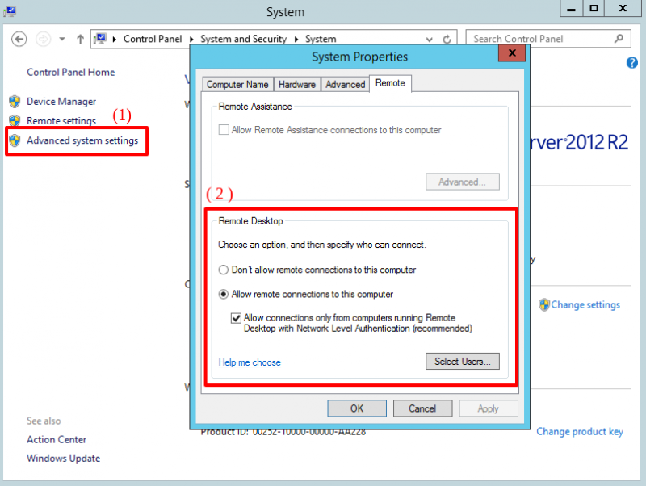
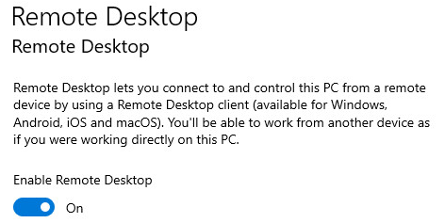
Enable Remote Desktop
Command Prompts:
Graphic Interface:

Slide 4
Configure Remote Desktop on DC
Group Policy managerment:
Server manager→tools→ Group Policy managerment
Edit cái Default Domain Controllers Policy: Computer Configuration→policies→Windows settings→Security Settings →Local Policies→User Rights Assignment.
Sau đó add user vào Allow Log on Locally và Allow Log on through Remote Desktop Services
Chú ý: phải add vào cả log on locally vì khi user remote tới máy chủ và muốn sử dụng các công cụ thì phải xác thực lần nữa trên chính máy chủ bằng chính user đó nên phải có quyền này mới mở được công cụ

Slide 5

Check if Someone is Network-Connected to Your PC
The netstat command displays network statistics. In its basic form (what you typed), current local connections to your computer are displayed. You see something like this if another computer is using one of your PC’s shared folders:

Slide 6
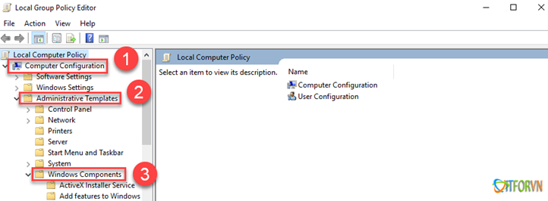
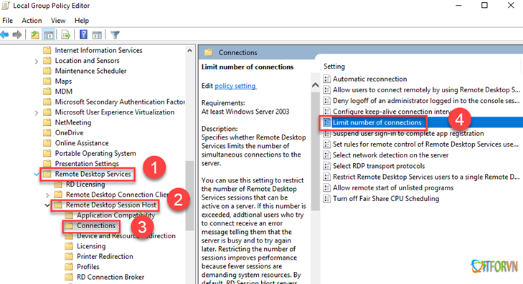
Allow multiple users to connect to a server

Slide 7
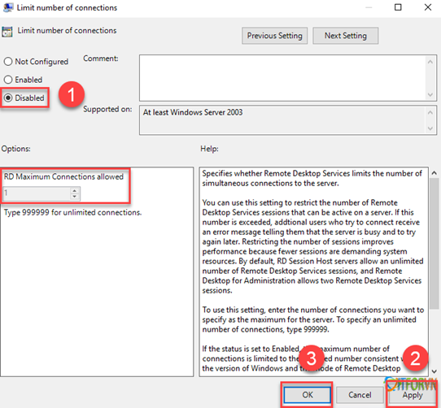
Allow multiple users to connect to a server
.
Select Disable to set unlimited connections.
Or you can select the maximum connections allowed

Slide 8
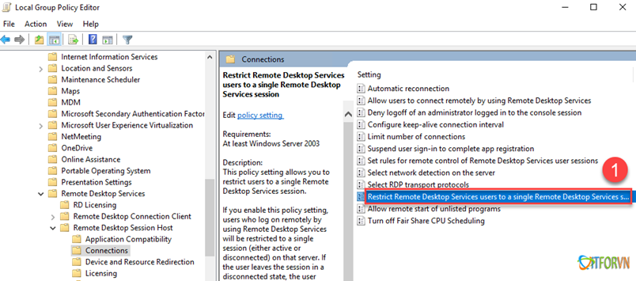
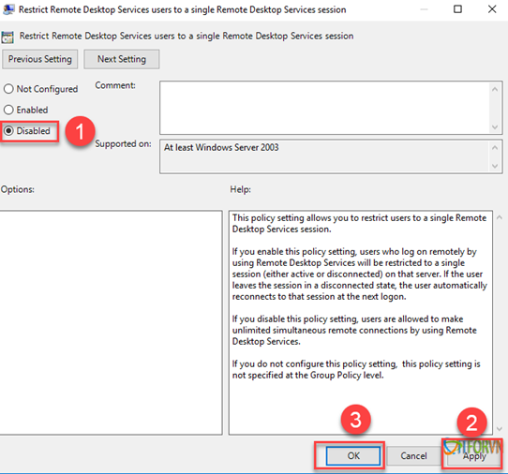
Allow multiple users to connect to a server
.

Slide 9
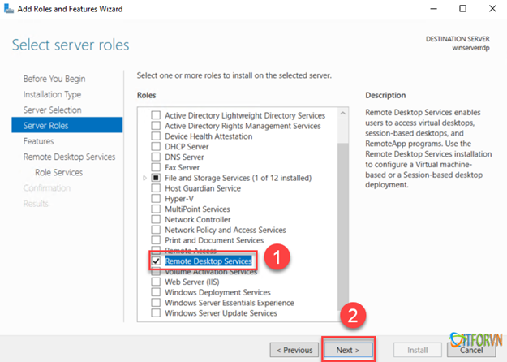
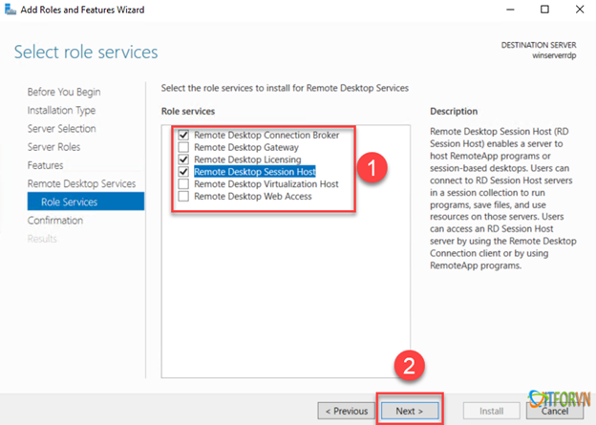
Install Remote Desktop services for multiple connections
.

Slide 10
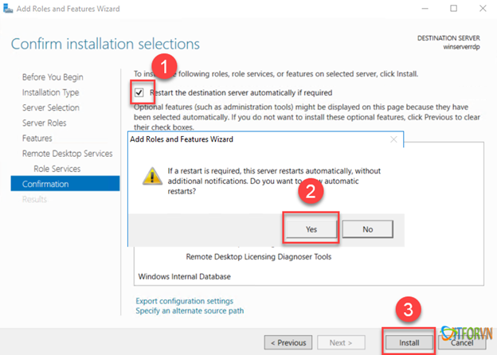
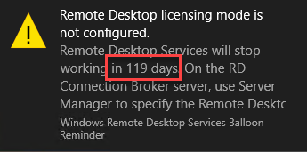
Install Remote Desktop services for multiple connections
.

Slide 11
Reset Terminal Server (RDS) Grace Licensing Period to Default 120 Days
.
Delete HKEY_LOCAL_MACHINE\SYSTEM\CurrentControlSet\Control\Terminal Server\RCM\GracePeriod

Slide 12
## This Script is intended to be used for Querying remaining time and resetting Terminal Server (RDS) Grace Licensing Period to Default 120 Days.
## Developed by Prakash Kumar (prakash82x@gmail.com) May 28th 2016
## www.adminthing.blogspot.com
## Disclaimer: Please test this script in your test environment before executing on any production server.
## Author will not be responsible for any misuse/damage caused by using it.
Param(
[Parameter(Mandatory=$false)] [Switch]$Force
)
Clear-Host
$ErrorActionPreference = "SilentlyContinue"
## Display current Status of remaining days from Grace period.
$GracePeriod = (Invoke-WmiMethod -PATH (gwmi -namespace root\cimv2\terminalservices -class win32_terminalservicesetting).__PATH -name GetGracePeriodDays).daysleft
Write-Host -fore Green ======================================================
Write-Host -fore Green 'Terminal Server (RDS) grace period Days remaining are' : $GracePeriod
Write-Host -fore Green ======================================================
Write-Host
## Check if -Force Parameter has been used, If so, It will not prompt for Y/N while executing the script and will simply reset the Grace Period.
If (-not $Force)
{
$Response = Read-Host "Do you want to reset Terminal Server (RDS) Grace period to Default 120 Days ? (Y/N)"
}
if ($Response -eq "Y" -or $Force) {
## Reset Terminal Services Grace period to 120 Days
$definition = @"
using System;
using System.Runtime.InteropServices;
namespace Win32Api
{
public class NtDll
{
[DllImport("ntdll.dll", EntryPoint="RtlAdjustPrivilege")]
public static extern int RtlAdjustPrivilege(ulong Privilege, bool Enable, bool CurrentThread, ref bool Enabled);
}
}
"@
Add-Type -TypeDefinition $definition -PassThru
$bEnabled = $false
## Enable SeTakeOwnershipPrivilege
$res = [Win32Api.NtDll]::RtlAdjustPrivilege(9, $true, $false, [ref]$bEnabled)
## Take Ownership on the Key
$key = [Microsoft.Win32.Registry]::LocalMachine.OpenSubKey("SYSTEM\CurrentControlSet\Control\Terminal Server\RCM\GracePeriod", [Microsoft.Win32.RegistryKeyPermissionCheck]::ReadWriteSubTree,[System.Security.AccessControl.RegistryRights]::takeownership)
$acl = $key.GetAccessControl()
$acl.SetOwner([System.Security.Principal.NTAccount]"Administrators")
$key.SetAccessControl($acl)
## Assign Full Controll permissions to Administrators on the key.
$rule = New-Object System.Security.AccessControl.RegistryAccessRule ("Administrators","FullControl","Allow")
$acl.SetAccessRule($rule)
$key.SetAccessControl($acl)
## Finally Delete the key which resets the Grace Period counter to 120 Days.
Remove-Item 'HKLM:\SYSTEM\CurrentControlSet\Control\Terminal Server\RCM\GracePeriod'
write-host
Write-host -ForegroundColor Red 'Resetting, Please Wait....'
Start-Sleep -Seconds 10
}
Else
{
Write-Host
Write-Host -ForegroundColor Yellow '**You Chose not to reset Grace period of Terminal Server (RDS) Licensing'
}
## Display Remaining Days again as final status
tlsbln.exe
$GracePost = (Invoke-WmiMethod -PATH (gwmi -namespace root\cimv2\terminalservices -class win32_terminalservicesetting).__PATH -name GetGracePeriodDays).daysleft
Write-Host
Write-Host -fore Yellow =====================================================
Write-Host -fore Yellow 'Terminal Server (RDS) grace period Days remaining are' : $GracePost
Write-Host -fore Yellow =====================================================
if ($Response -eq "Y" -or $Force)
{
Write-Host -Fore Cyan `n"IMPORTANT: Please make sure you restart following services manually to bring this reset in effect:`n`n* Remote Desktop Configuration Properties `n* Remote Desktop Services"
}
## Cleanup of Variable
Remove-Variable * -ErrorAction SilentlyContinue
##End of Code##
Notes:
.\Reset-TSGracePeriod.ps1 -Force

Slide 13
License your RDS deployment with client access licenses (CALs)
https://docs.microsoft.com/en-us/windows-server/remote/remote-desktop-services/rds-client-access-license

